Slide 1







Interacting with Tiny bit
Handle remote control
Yahboom

Slide 2










Contents
Preparation
Learning goal
Tiny bit code
Handle code
Download code
Experimental phenomena
Yahboom

Slide 3

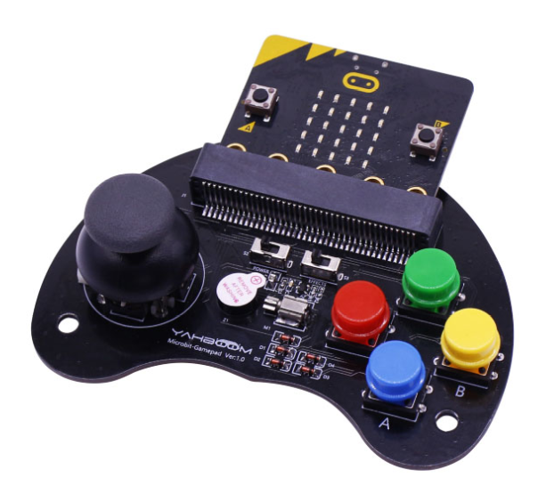
Preparation
Learn how to use micro:bit handle
Learn how to communicate between the Tiny-bit robot car and the micro:bit handle
The handle is shown below. The communication between the Tiny-bit robot car and the micro:bit handle is the communication between two micro:bit boards. They use the wireless networking communication method.
Yahboom

Slide 4
Preparation
Programming method:
Mode 1 online programming: First, we need to connect the micro:bit to the computer by USB cable. The computer will pop up a USB flash drive and click on the URL in the USB flash drive: http://microbit.org/ to enter the programming interface. Add the Yahboom package: https://github.com/YahboomTechnology/Tiny-bitLib and https://github.com/yahboomtechnology/ghbitlib to program.
Mode 2 offline programming: We need to open the offline programming software. After the installation is complete, enter the programming interface, click【New Project】, add Yahboom package:https://github.com/YahboomTechnology/Tiny-bitLib and https://github.com/yahboomtechnology/ghbitlib you can program.
Yahboom

Slide 5
Learning goal
1.Learn about using Radio graphically programming blocks
2.Learn about using GHBit graphically programming blocks
3.Learn how to use micro:bit handle control Tiny bit robot car
Yahboom

Slide 6

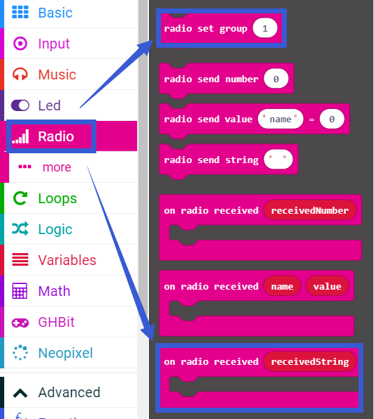
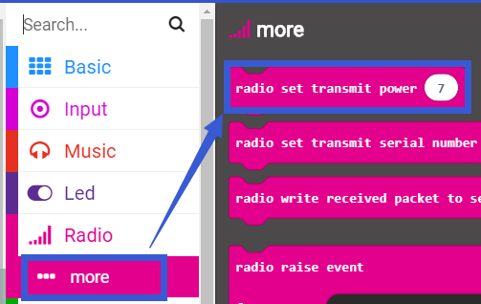
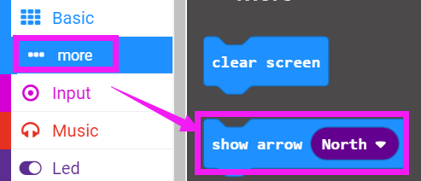
Tiny bit code
The following is the location of the building blocks required for this Tiny bit programming.
Yahboom

Slide 7
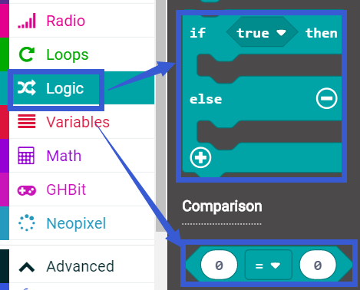
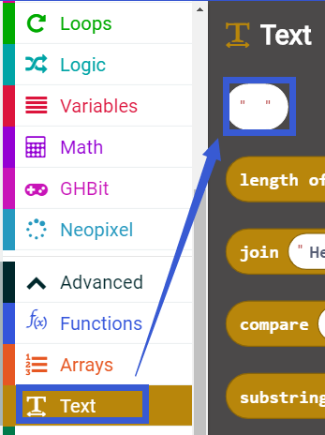
Tiny bit code
Yahboom

Slide 8
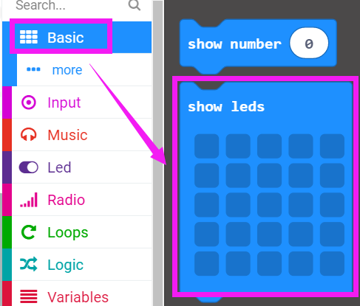
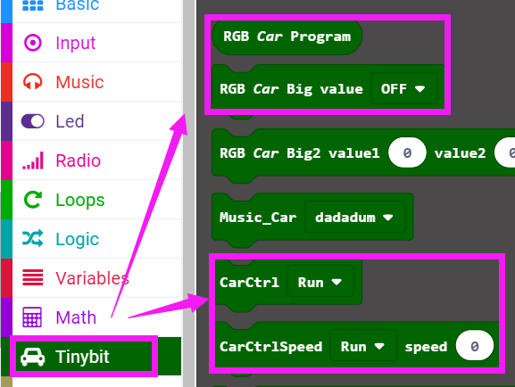
Tiny bit code
Yahboom

Slide 9
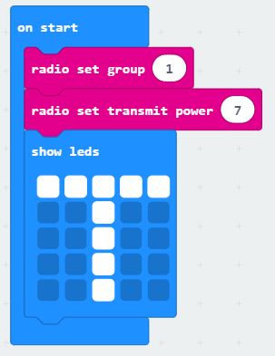
Tiny bit code
The summary program of Tiny bit is shown below:
Yahboom

Slide 10
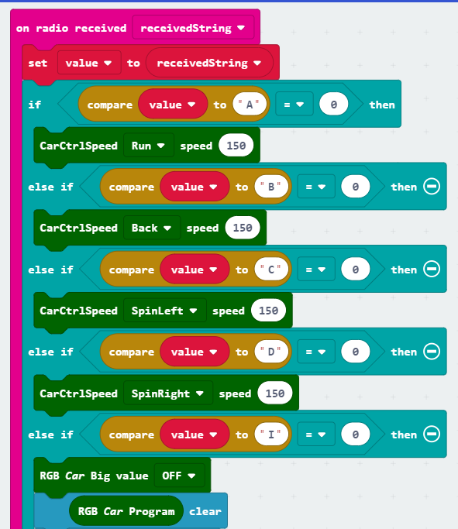
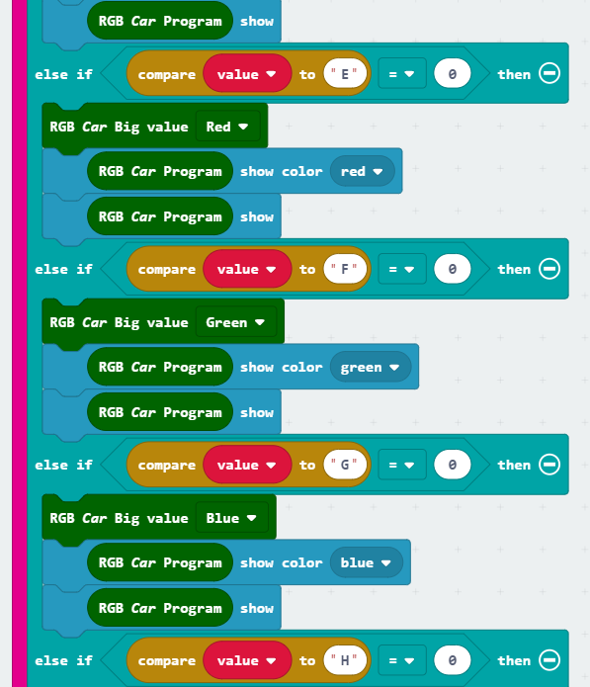
Tiny bit code
Yahboom

Slide 11
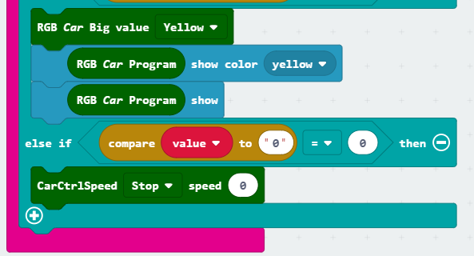
Tiny bit code
Yahboom

Slide 12
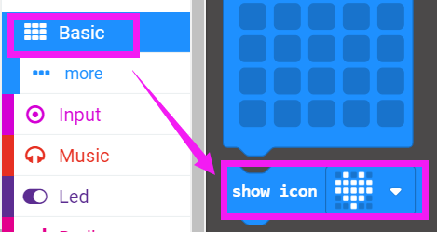
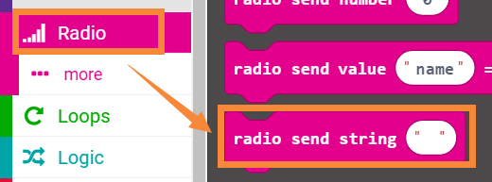
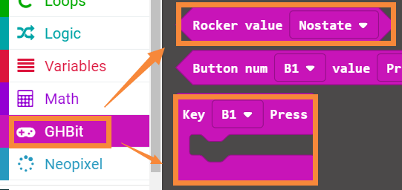
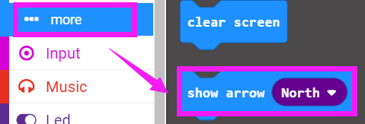
Handle code：rocker control
The following is the location of the building blocks required for this handle code programming.
Yahboom

Slide 13
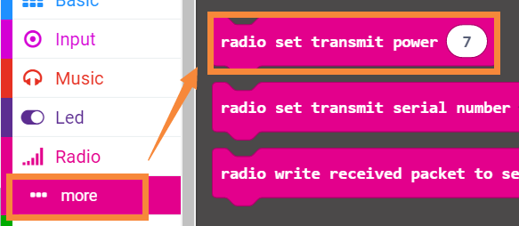
Handle code：rocker control
Yahboom

Slide 14
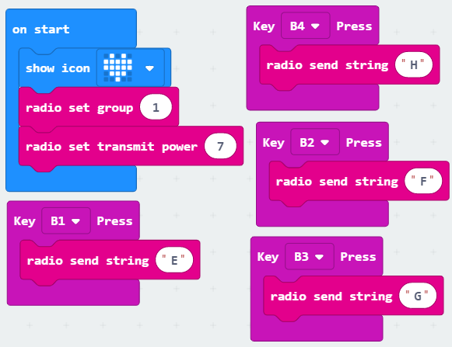
Handle code：rocker control
The summary program of handle rocker control is shown below:
Yahboom

Slide 15
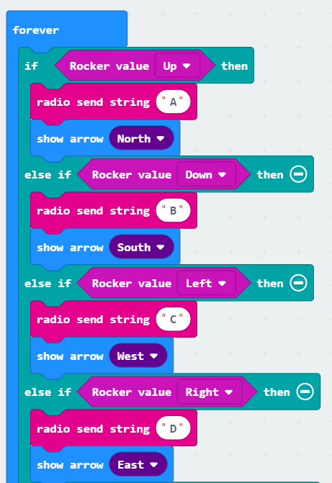
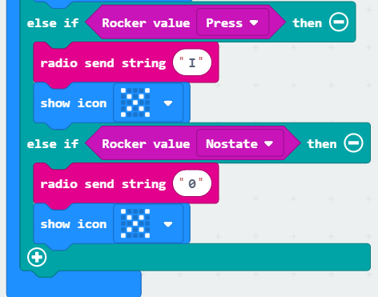
Handle code：rocker control
Yahboom

Slide 16
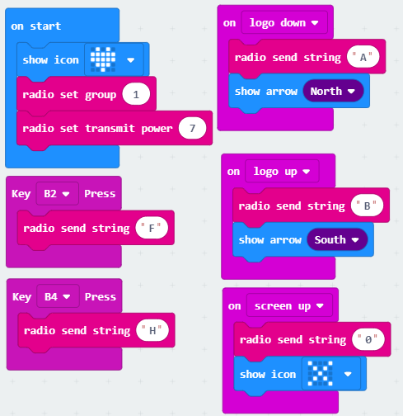
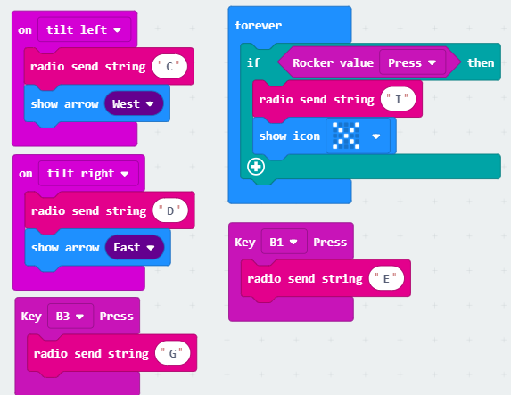
Handle code：gravity control
The summary program of handle gravity control is shown below:
Yahboom

Slide 17
Download code
First, we need to download the microbit-Tiny-bit-code.hex to the micro:bit board on the Tiny-bit robot car.
Then, we need to download the handle control program (microbit-Handle_rocker_control.hex/microbit-Handle-gravity-control.hex) to the micro:bit board on the handle.
Yahboom

Slide 18
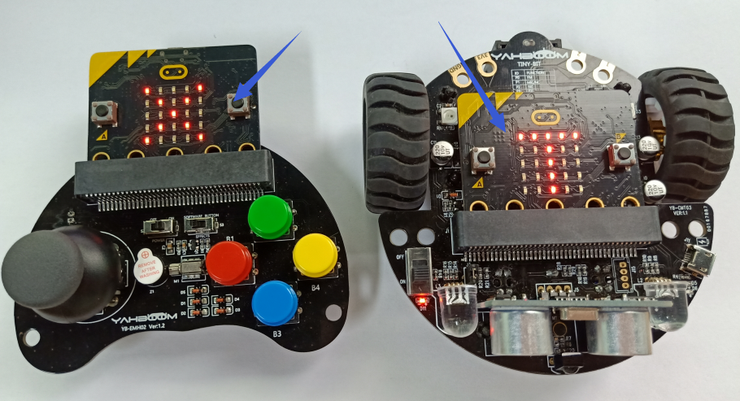
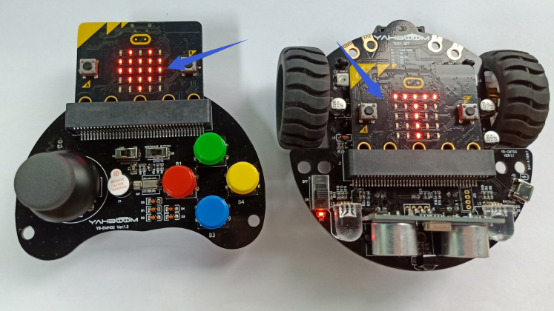
Experimental phenomena
After the download is complete, open the power of the car. We can see that the microbit dot matix display a “T” pattern. Open the power of the handle. We can see a heart pattern on the handle and then display an “X”, as shown below.
Next, we can control robot car by handle.
Yahboom

Slide 19
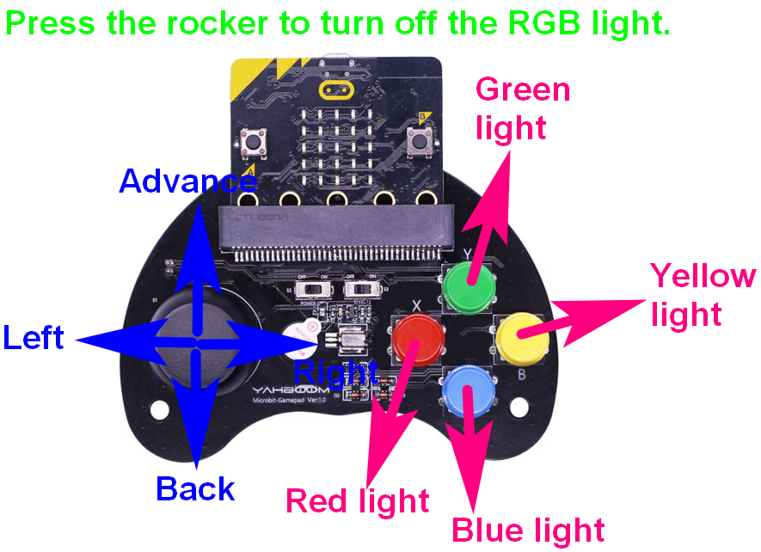
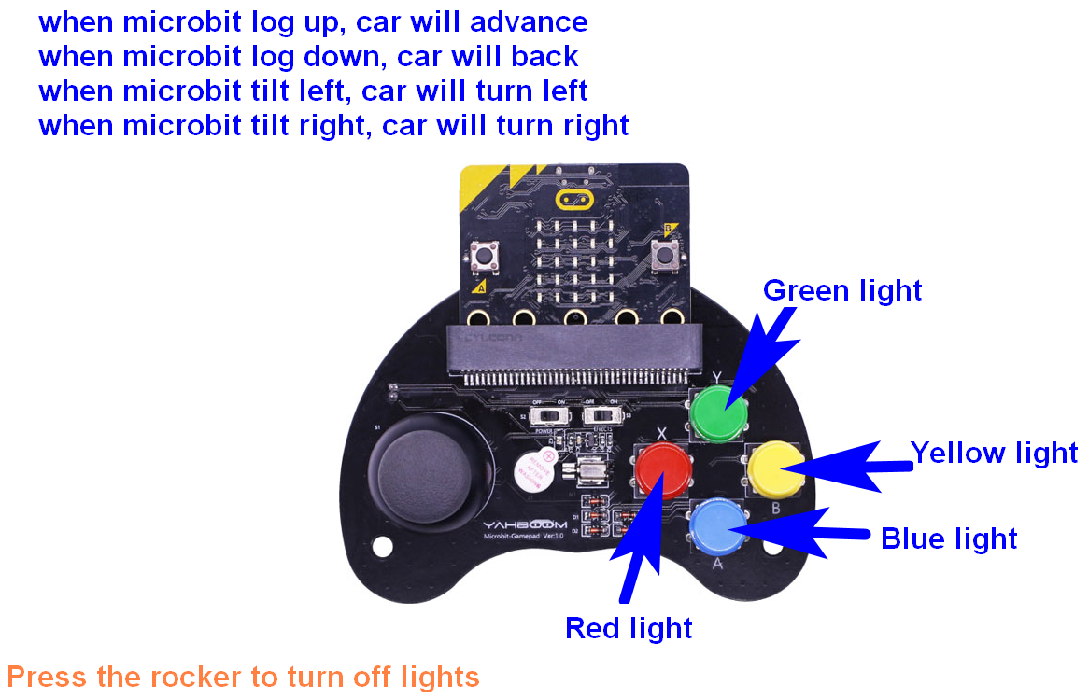
Experimental phenomena
The corresponding function of the rocker control is as shown below:
The corresponding function of the gravity control is as shown below:
Yahboom

Slide 20
Inspire Creativity Embrace Innovation
Thank you!!!

